Slide 1
Logistic regression

Slide 2
Logistic Regression :
The logistic Regression is a ML algorithm which is used for the
Classification problems, it is a predictive analysis algorithm and based
On the concept of probability ….
The hypothesis of logistic regression tends it to limit the cost function between 0 and 1 .

Slide 3
Example:
1) A logistic regression could be used to predict whether a political candidate will win or lose an election.
2) whether a high school student will be admitted to a particular collage .
3) To predict weather an email is spam (1) or (0) whether the tumor is malignant (1) or not (0).

Slide 4
Function using in logistic regression
Logistic regression uses a more complex cost function
can be defined as the “Sigmoid Function” or also known as the “Logistic Function” instead of a linear function .

Slide 5
Sigmoid Function :
A sigmoid function is a bounded, differentiable, real function that is defined for all real input values and has a non-negative derivative at each point and exactly one inflection point. A sigmoid “ function ” and a sigmoid curve refer to the same object .
It simply takes on a characteristic “s” shaped curve .

Slide 6
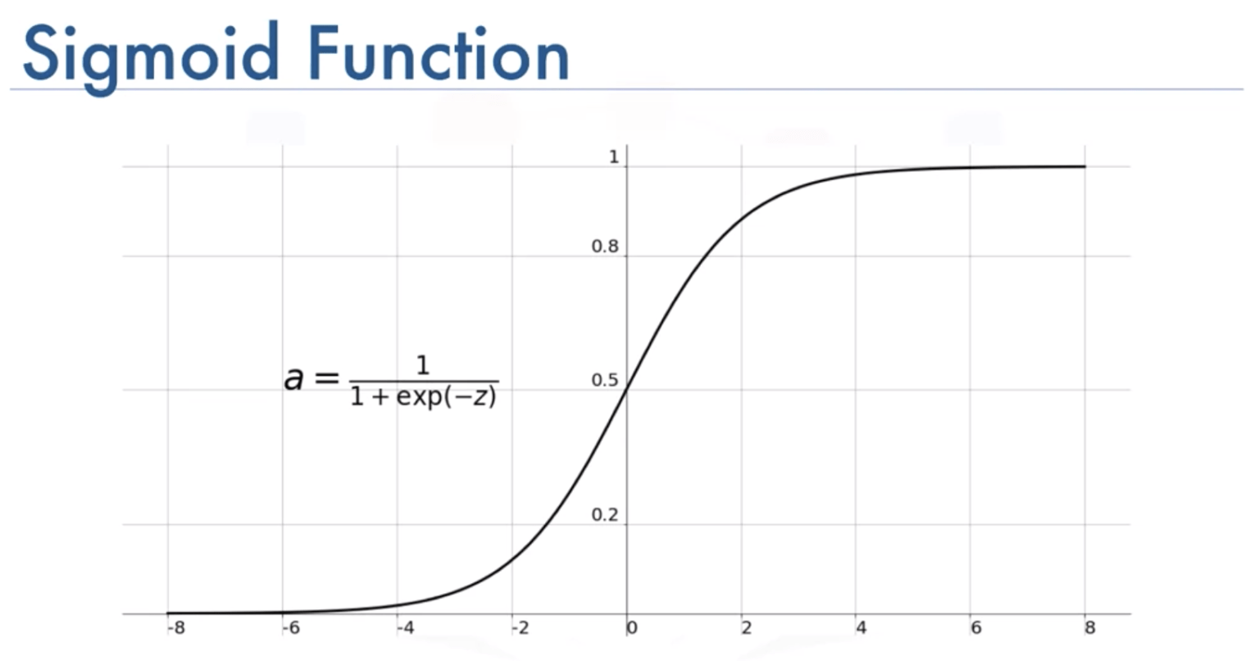
This Photo by Unknown Author is licensed under CC BY

Slide 7
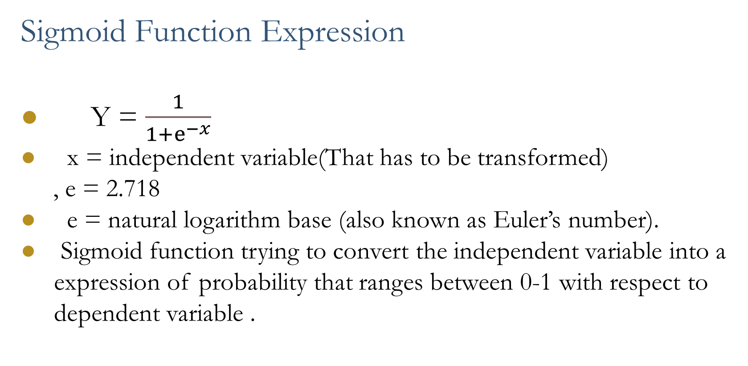
Sigmoid Function Expression
Y = $\frac{1}{1+ⅇ^{−x}}$
x = independent variable(That has to be transformed)
, e = 2.718
e = natural logarithm base (also known as Euler’s number).
Sigmoid function trying to convert the independent variable into a expression of probability that ranges between 0-1 with respect to dependent variable .

Slide 8
Application of Logistic Regression
This is the scenario of Binary classification.
Fraud detection .
Disease Diagnosis.
Emergency detection.
Spam no spam.
Predicting the mortality of injured patients.

